Slide 1
Hotel Booking Cancellation
Manal AlSaleh

Slide 2
Agenda
Problem Statement
Data Description
Exploratory of Data Analysis ( EDA )
Data Cleaning
Modeling

Slide 3
Problem Statement
Hotel Booking Cancellation Impact:
High Distribution Cost
High Opportunity Cost
Lost of revenue

Slide 4
Data Description
Data for 119,390 bookings
32 variables ( 12 Categorical columns and 20 Numerical columns)
Period 2015 - 2017

Slide 5
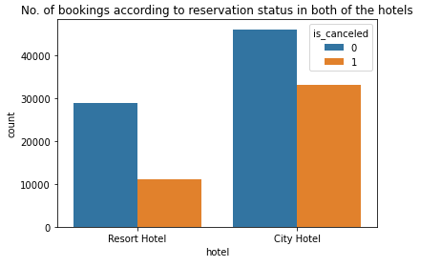
Exploratory of Data Analysis
Is Canceled : Balanced Dataset

Slide 6
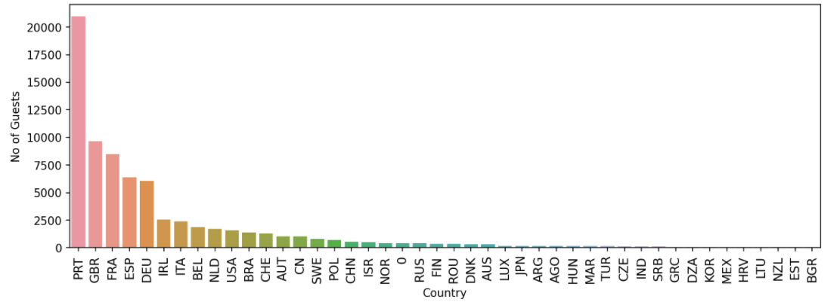
Exploratory of Data Analysis
From where the most guests are coming?
Majority of booking are from PRT ( Portugal )

Slide 7
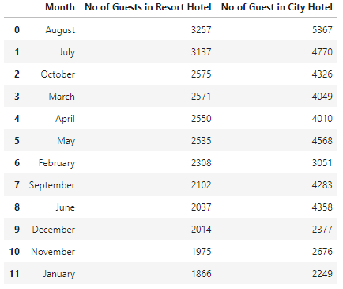
Exploratory of Data Analysis
Which are the busiest month?
The more bookings in the summer.

Slide 8
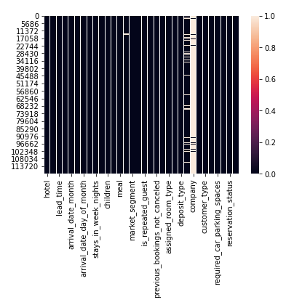
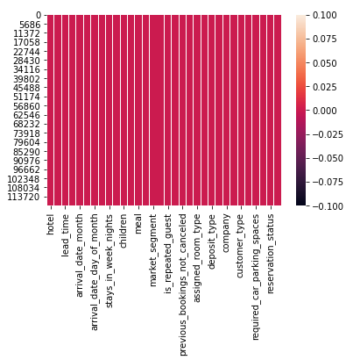
Data Cleaning
To check if we have missing values, then we will have to replace those missing values with the mean of that feature if that variable is numeric or the constant if it is a categorical feature.

Slide 9
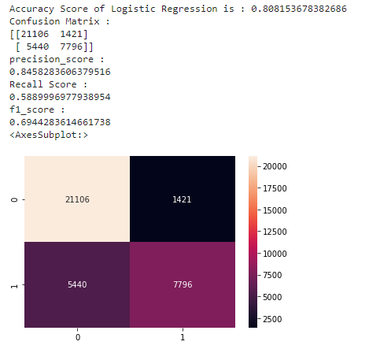
Modeling
Logistic Regression

Slide 10
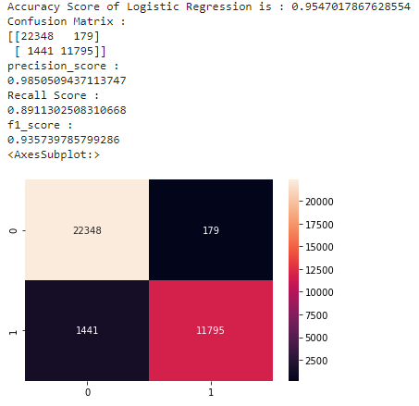
Modeling
Random Forest

Slide 11
Thank You

